Slide 1
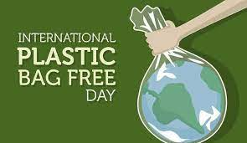
Plastic Bag Free Day
“Plastics give a helping and, but they are polluting our land!”.

Slide 2
PLASTIC FACTS
Every year, 500 billion plastic bottles are produced worldwide.
In 2022 we will generate more than 500 million tons of plastic, 900% more than in 1980
Plastic in the ocean is already more than 150 million tons of waste.
By 2050, they could contain more plastics than fish
Each year around eight million tons of plastic ends up in our seas and oceans

Slide 3
Plastic Bag advantages and disadvantages
advantages
Disadvantages
Plastic bags are cheaper than their paper alternatives.
They are hugely favored by retailers and customers alike.
Plastic bags are very easy to use.
Plastic Affects marine life adversely.
They are made of crude oil and natural gas which are non-renewable sources of energy.
Plastics can cause Global Warming

Slide 4
REDUCING TE USE OF PLASTIC
If you go shopping, remember to take a cloth bag
Avoid single-use plastics such as drinking straws
Buy more bulk food and fewer packaged products
Replace plastic Tupperware for glass or steel containers
Pay attention and put your plastic waste in the correct recycling container

Slide 5
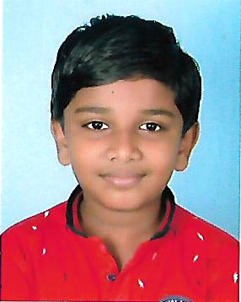
Reduce your plastic consumption and lessen its impact on the environment
THE END...
Name: SARANG R SANAL
Class: 7A
Roll No: 31
School: C.V.K

