Slide 1
International Plastic
Free Day

Slide 2
International Plastic Bag Free Day
On July 3, is a global initiative that aims to eliminate the use of plastic bags.
when the world reminds itself of the importance to reduce the usage of plastic in everyday life.
Plastic pollution is a global catastrophe and sadly it is a man-made one
Did you know that approximately 500 billion plastic bags are used on a global

Slide 3
Humans are prey of plastics, so we can hold hands together for a plastic free- world
We can move from harm plastic to eco- friendly paper………

Slide 4
How to celebrate ?
Recycle all the plastic in your house and office
Say no to single-use plastic bags.
Take your own cloth or paper bag when you go shopping.
Not only will you be saving money – several grocery stores give discounts for patrons bringing in their own bags, you will also be helping to save the environment.

Slide 5
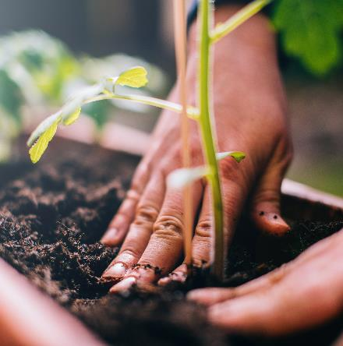
Steps to become plastic free….
Come together
Be eco friendly
New world
Avoid plastic

Slide 6
Plastic to Paper

Slide 7
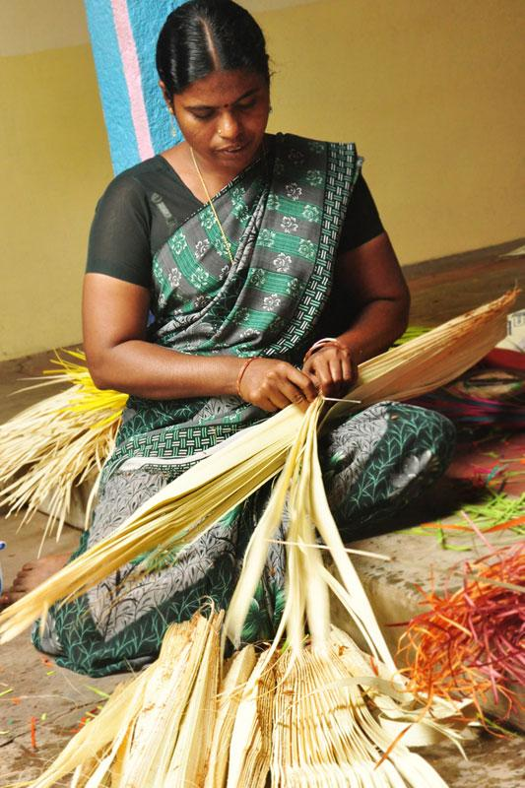
PLASTIC TO PALM....

Slide 8
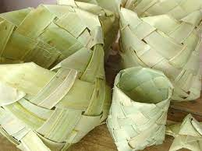
Palm leaf bags

Slide 9
Thank you

